Slide 1
When Should Humans Overrule AI?
CodeClan - Ethics Project
Calum Sey

Slide 2
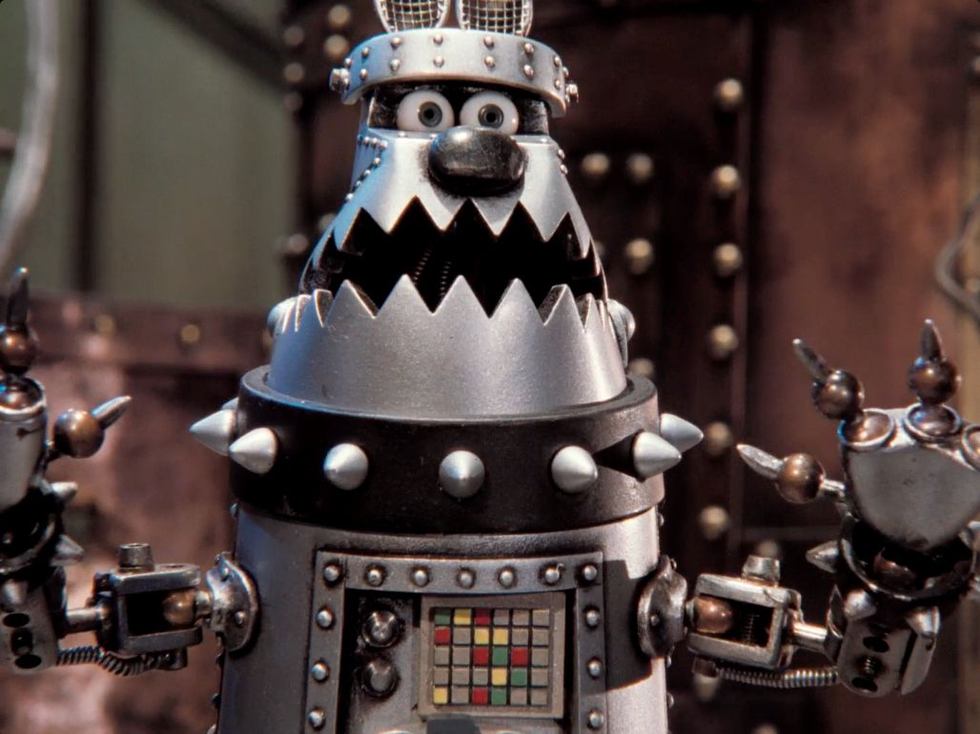
The Limitation of AI?
-Why do we need to take control?
-Do we only stop the problem just before catastrophe?
-Is It Correct to Step In?

Slide 3
Why do we need to take Control?
To prevent a major accident?
When we don’t understand or trust it’s decisions?
Who’s technically right in the end?

Slide 4
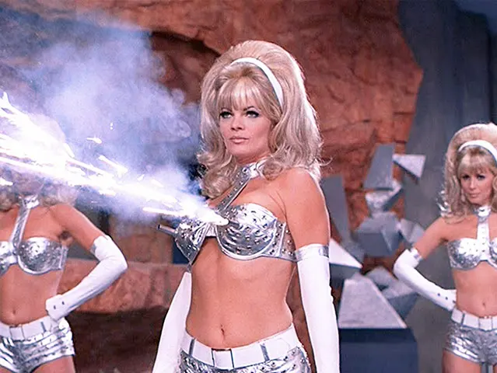
Just before Catastrophe?
- Taking Manual Control
- In the Laws that we make
-Who’s technically right in the end?

Slide 5
Is it Correct to Step In?
What defines the step to Override AI?
Who determines if the AI or Human input is right or wrong?
Do we judge AI on the same terms as ourselves?

Slide 6
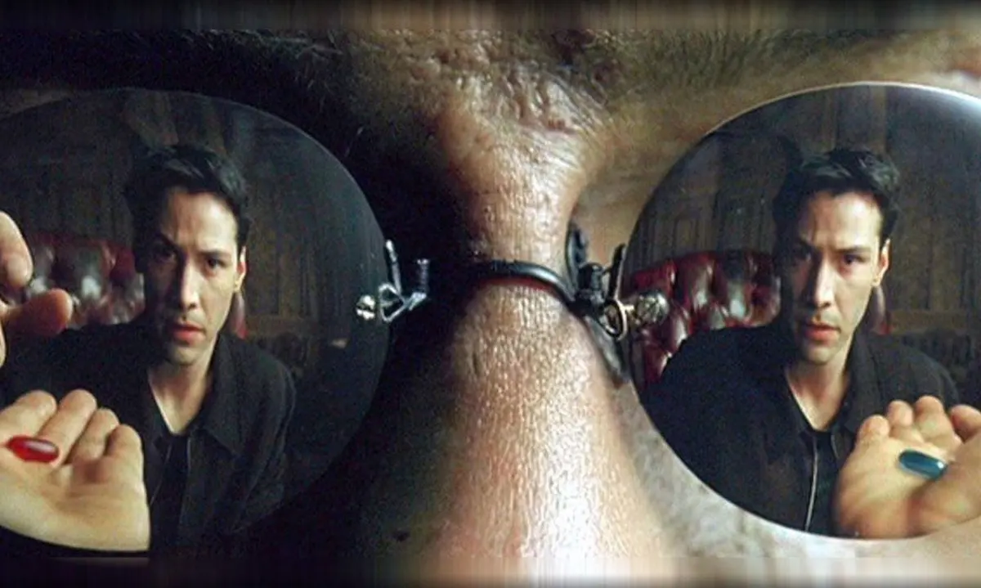
Tumbling Down the Rabbit Hole
P.s thanks for listening

